Slide 1
Lending Club Case Study
Athira S Menon
Pooja Dalvi

Slide 2
Problem Statement
Background :
Lending Club is a consumer finance company which specializes in lending various types of loans to urban customers.
When the company receives a loan application, the company has to make a decision for loan approval based on the applicant’s profile.
Two types of risks are associated with the bank’s decision:
If the applicant is likely to repay the loan, then not approving the loan results in a loss of business to the company
If the applicant is not likely to repay the loan, i.e. he/she is likely to default, then approving the loan may lead to a financial loss for the company.
Objective :
Able to identify risky loan applicants so that such loans can be reduced thereby cutting down the amount of credit loss.
Identification of such applicants using EDA is the aim of this case study.
Perform an analysis to understand the driving factors (or driver variables) behind loan default, i.e. the variables which are strong indicators of default.
So that company can utilize this knowledge for its portfolio and risk assessment.

Slide 3
Analysis Approach
Data Exploration :
Understanding the metadata
Checking for presence of null value or duplicate rows
Data Cleaning
Perform imputation techniques for missing value.
Dropping irrelevant columns
Standardizing values
Removing columns with single value

Slide 4
Analysis Approach
Univariant analysis
Understand the statistics of each column with describe() function in pandas
Plot box plot and distribution chart to understand data distribution.
Identify outliers: Outliers values are removed from data.
Plot count plot for each column and observations are noted for both categorical and continuous variables
Bivariant Analysis
Correlation matrix is used to understand the correlation among data variables.
Analyze annual income with other column using barplot for more insights
Analyze loan amount with other column using barplot for more insights

Slide 5
Observations – Data Exploration & Data Cleaning
Total no. of attributes : 111
Total no. of rows : 39717
No. of Duplicate rows : 0
No. of Columns having all null values : 54
No. of Columns having single value : 9
Final shape of data after removing irrelevant data : (39717, 21)

Slide 6
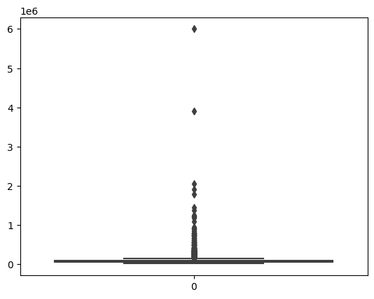
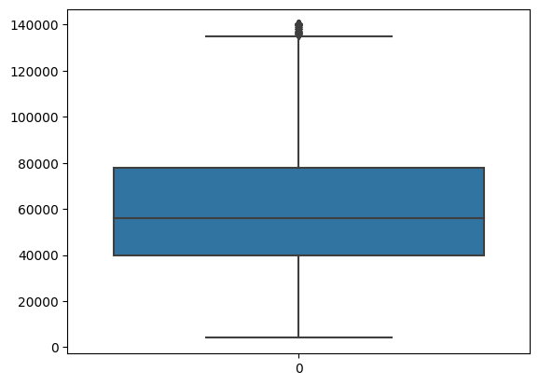
Observation– Univariant Analysis
Boxplot of column ‘annual_inc’ reveals presence of outlier
Box plot with outlier
Box plot after removing outlier

Slide 7
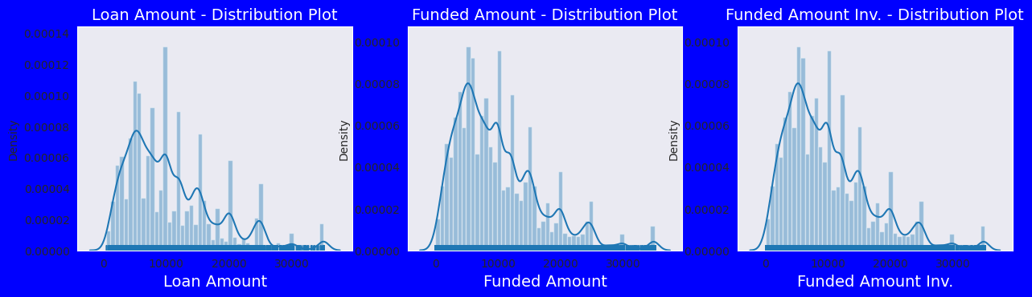
Observation – Univariant Analysis
Distribution plot of loan amount, funded amount and funded amount Inv. Reveals that data distribution is same for all three variables hence analysis is done only on loan amount.

Slide 8
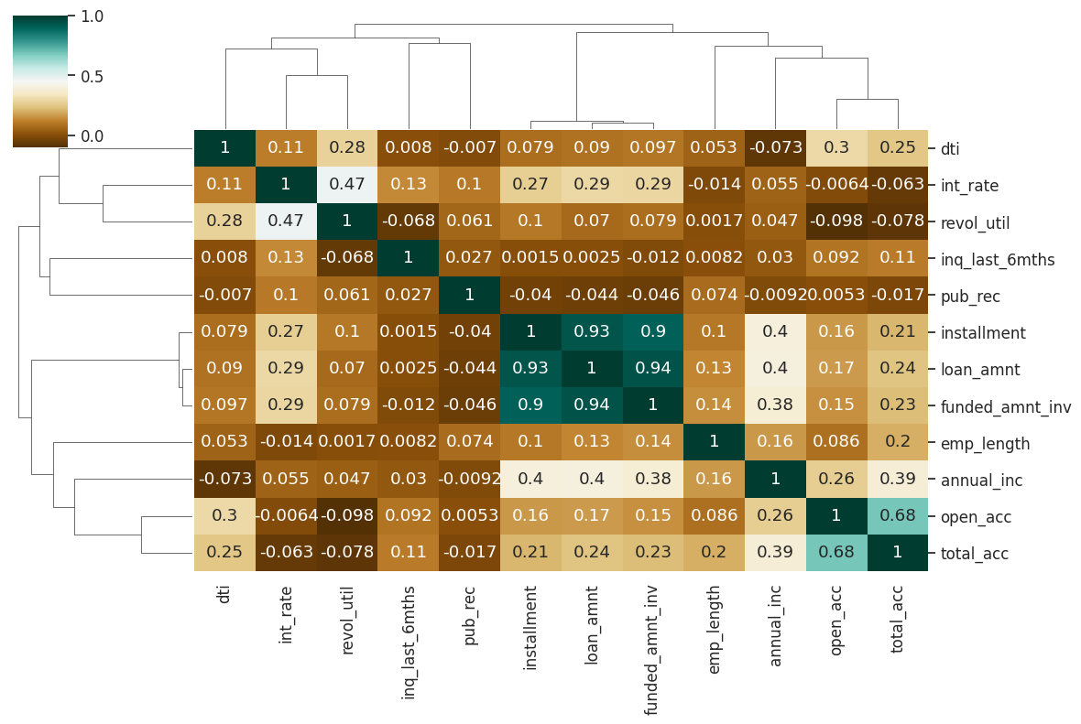
Observation – Correlation matrix
Loan amount, investor amount, funding amount are strongly correlated.
Annual income with DTI(Debt-to-income ratio) is negatively correlated.
Debt income ratio is the percentage of a consumer's monthly gross income that goes toward paying debts. That means when annual income is low DTI is high & vice versa.
Positive correlation between annual income and employment years.That means income increases with work experience

Slide 9
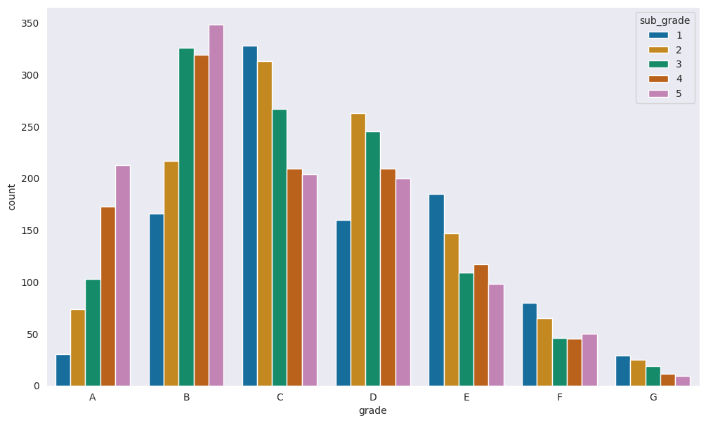
Observation – Univariant Analysis
Most borrowers fall under B grades and sub grade as 5 are likely to be defaulters

Slide 10
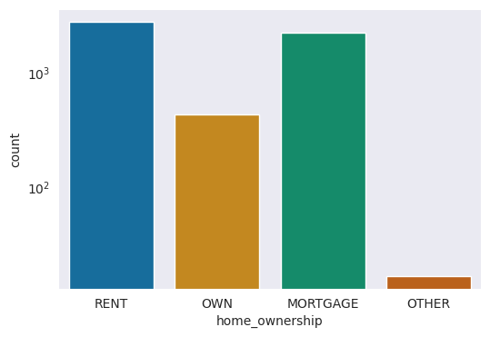
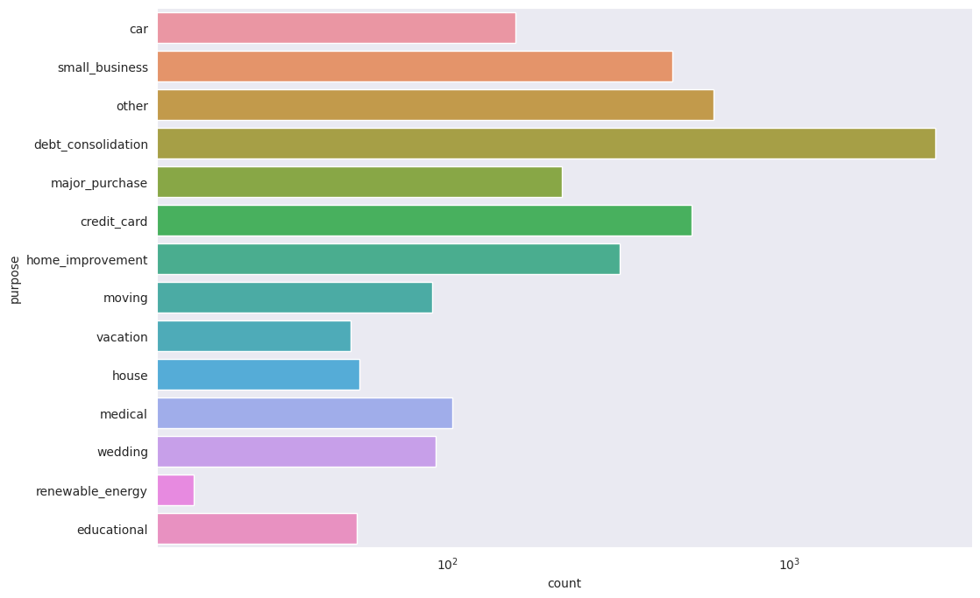
Observation – Univariant Analysis
Most of them living in rented home or mortgaged their home has charged off is high too.
Most of the loans were taken for the purpose of debt consolidation & paying credit card bill.

Slide 11
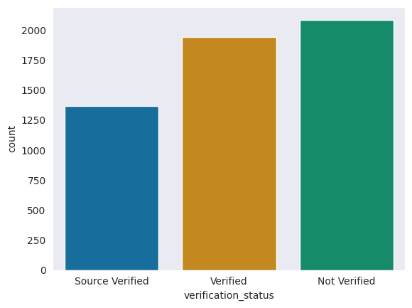
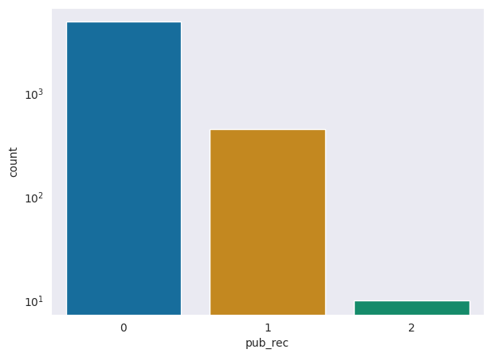
Observation – Univariant Analysis
When loan status is Not verified chance of defaulting loan is more
Applicants having number of derogatory public records is 0 are more likely to be defaulters

Slide 12
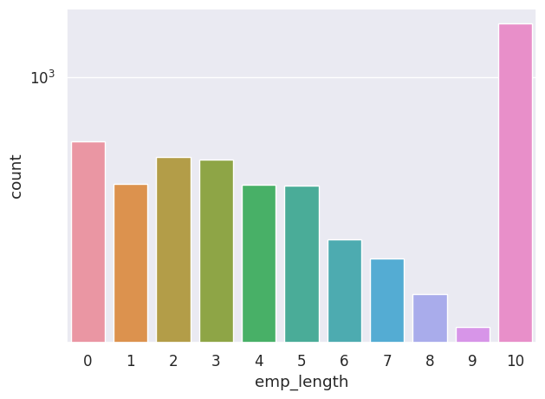
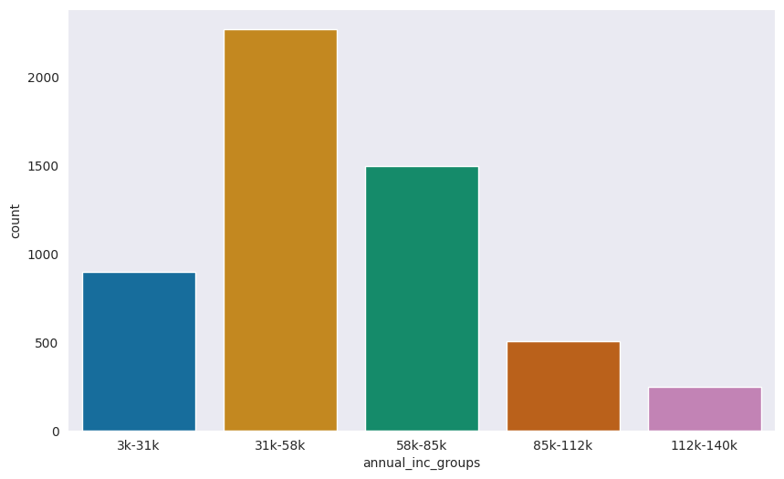
Observation – Univariant Analysis
Employee having more year of experience greater than 10 years are more like to default loan
Applicants with annual income in range of 31k to 58k are more likely to be defaulters

Slide 13
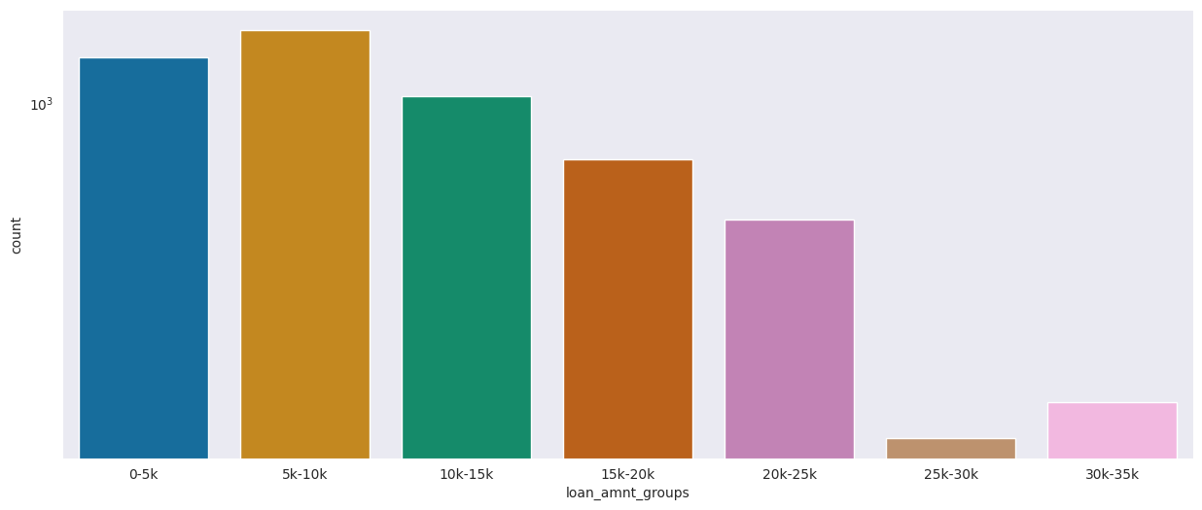
Observations from Univariant Analysis
Loan amount is between 5429 - 10357 applicants are more likely to be defaulters

Slide 14
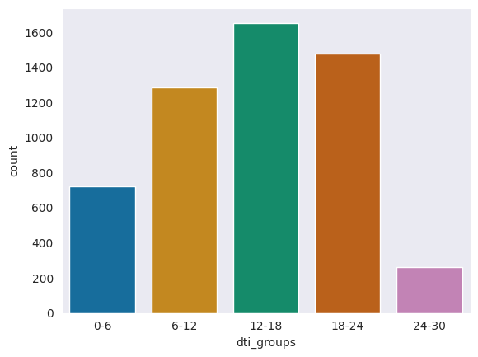
Observations from Univariant Analysis
DTI is between 12-18 applicants are more likely to be defaulters

Slide 15
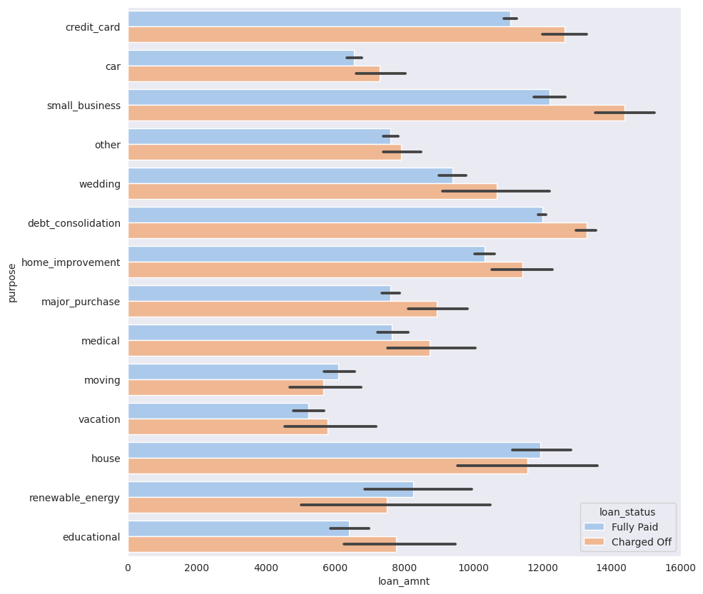
Observation – Bivariant Analysis
Though the number of loans applied and defaulted are the highest in number for "debt_consolation", the annual income of those who applied isn't the highest.
Applicants with higher salary mostly applied loans for "home_improvment", "house", "renewable_energy" and "small_businesses"
Applicants taking loan for 'home improvement' and have income of 60k -70k are more likely to be defaulters

Slide 16
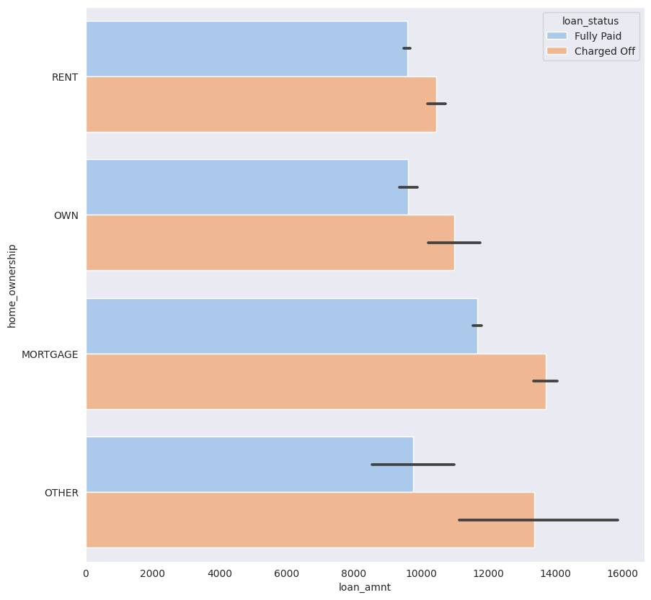
Observation – Bivariant Analysis
Applicants whose home ownership is 'MORTGAGE and have income of 60-70k are more likely to be defaulters

Slide 17
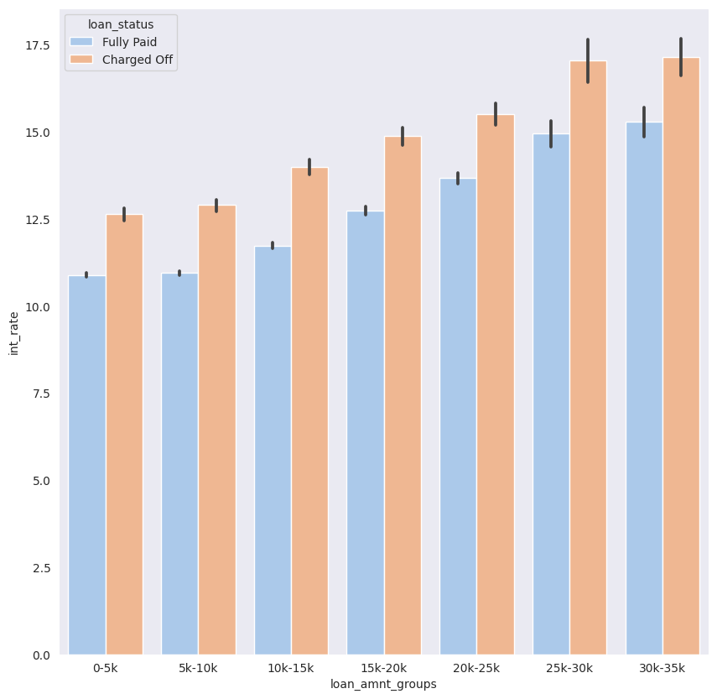
Observation – Bivariant Analysis
Applicants who receive interest at the rate of 21-24% and have an income of 70k-80k are more likely to be defaulters

Slide 18
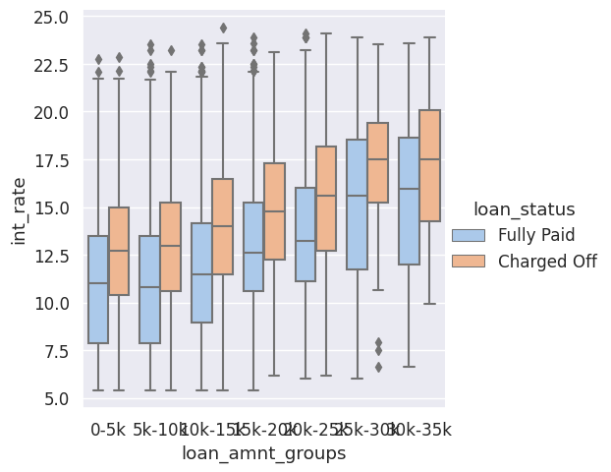
Observation – Bivariant Analysis
The interest rate for charged off loans is pretty high than that of fully paid loans in all the loan_amount groups.
This can be a pretty strong driving factor for loan defaulting.

Slide 19
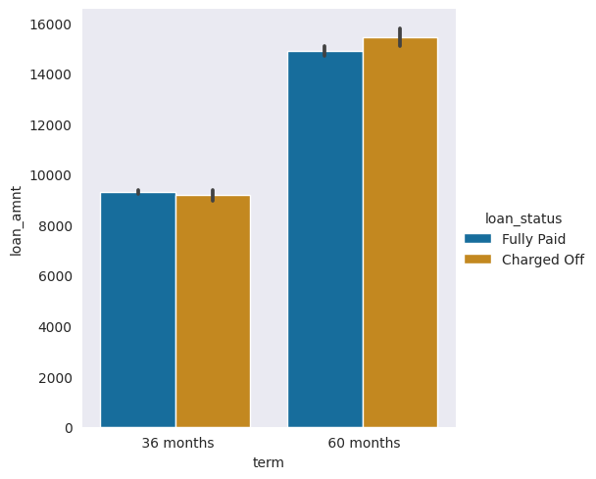
Observation – Bivariant Analysis
Applicants who applied and defaulted have no significant difference in loan_amounts
Which means that applicants applying for long term has applied for more loan.

Slide 20
Recommendations
Major driving factors for to predict chance of defaulters are grades, verification status, annual income, DTI, pub_rec
Other factors such as borrowers having annual income in the range 50000-100000, Burrowers with working experience 10+ years are more likely to be defaulters.
Applicants whose home ownership is 'MORTGAGE’ are more likely to be defaulters
Increased interest rate is a strong factor for deafulting loan amount.

Slide 21
THANKYOU

